Slide 1
Threading
Can handle multiple clients concurrently
Shared resources must be synchronized
or create a servlet that handles one request at a time
public class ReceiptServlet extends HttpServlet
implements SingleThreadModel {
public void doPost(HttpServletRequest request,
HttpServletResponse response)
throws ServletException, IOException {
... } ... }

Slide 2
Server Side Programming
Common Gateway Interface (CGI): Scripts generate Web pages or other files dynamically by processing form data and returning documents based on form values or other data
Plug-ins: Proprietary extensions of server logic. (ISAPI, NSAPI). Custom code extensions running in Server memory space

Slide 3
Server-side Includes: Extension to HTML. Server-side scripting. Embedding code in HTML documents.
Java Server Pages: JavaServer Pages technology uses XML-like tags and scriptlets written in the Java programming language to encapsulate the logic that generates the content for the page. Dynamic data in web page. JSP compiled to Servlet

Slide 4
HTML Forms
Interactive HTML
Composed of input elements (buttons, text fields, check boxes) witn <form> tag
On Submission, browser packages user input and sends to server
Server passes information to supporting application that formats reply (HTML page)

Slide 5
<form> Tag
<form> </form> comprise single form
Two Special Attributes: Name of forms processing server and method to pass parameters to server (Third for security)
action attribute give URL of application that receives and processes forms data (cgi-bin)
<form action=http://www.kumquat.com/cgi-bin/update>

</form>

Slide 6
enctype attribute to change encryption
method attribute sets the method by which data sent to server
POST: Data sent in two steps. Designed for Posting information.
  Browser contacts server
  Sends data
GET: Contacts server and sends data in single step. Appends data to action URL separated by question mark. Designed to get information.

Slide 7
Other Methods
HEAD: Client sees only header of response to determine size, etc
PUT: Place documents directly on server
DELETE: Opposite of PUT
TRACE: Debugging aid returns to client contents of its request
OPTIONS: what options available on server

Slide 8
<form method=GET
action=http://www.kumquat.com/cgi-bin/update>

</form>
http://www.kumquat.com/cgi-bin/update?x=19&y=104

Slide 9
<HTML>
<HEAD>
<TITLE>Introductions</TITLE>
</HEAD>
<BODY>
<FORM METHOD=GET ACTION="/servlet/Hello">
If you don't mind me asking, what is your name?
<INPUT TYPE=TEXT NAME="name"><P>
<INPUT TYPE=SUBMIT>
</FORM>
</BODY>
</HTML>

Slide 10
import java.io.*;
import javax.servlet.*;
import javax.servlet.http.*;
public class Hello extends HttpServlet {
public void doGet(HttpServletRequest req, HttpServletResponse res)
throws ServletException, IOException {
// Set the Content-Type header
res.setContentType("text/html");
// Return early if this is a HEAD
if (req.getMethod().equals("HEAD")) return;
// Proceed otherwise
PrintWriter out = res.getWriter();
String name = req.getParameter("name");
out.println("<HTML>");
out.println("<HEAD><TITLE>Hello, " + name + "</TITLE></HEAD>");
out.println("<BODY>");
out.println("Hello, " + name);
out.println("</BODY></HTML>");
}
public void doPost(HttpServletRequest req, HttpServletResponse res)
throws ServletException, IOException {
doGet(req, res);
}
}

Slide 11
<HTML>
<HEAD>
<TITLE>Introductions</TITLE>
</HEAD>
<BODY>
<FORM METHOD=GET ACTION="/servlet/Hello">
If you don't mind me asking, what is your name?
<INPUT TYPE=TEXT NAME="name"><P>
<INPUT TYPE=SUBMIT>
</FORM>
</BODY>
</HTML>

Slide 12
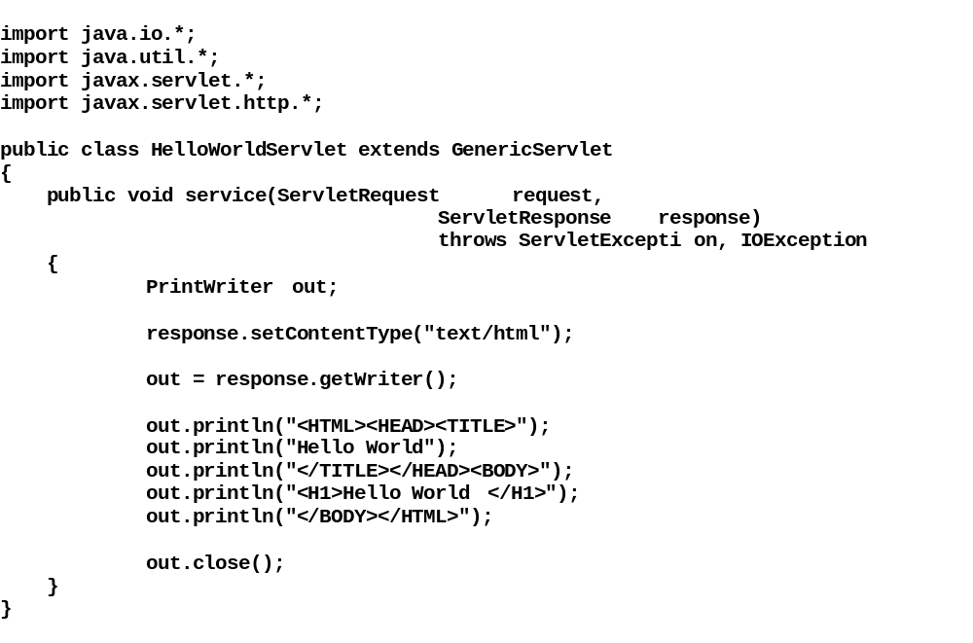

Slide 13
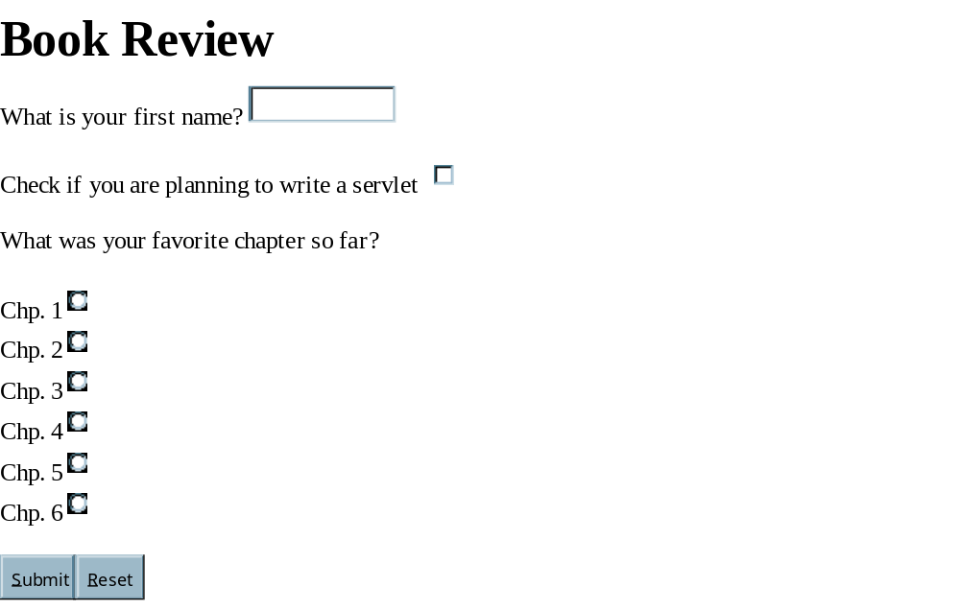

Slide 14
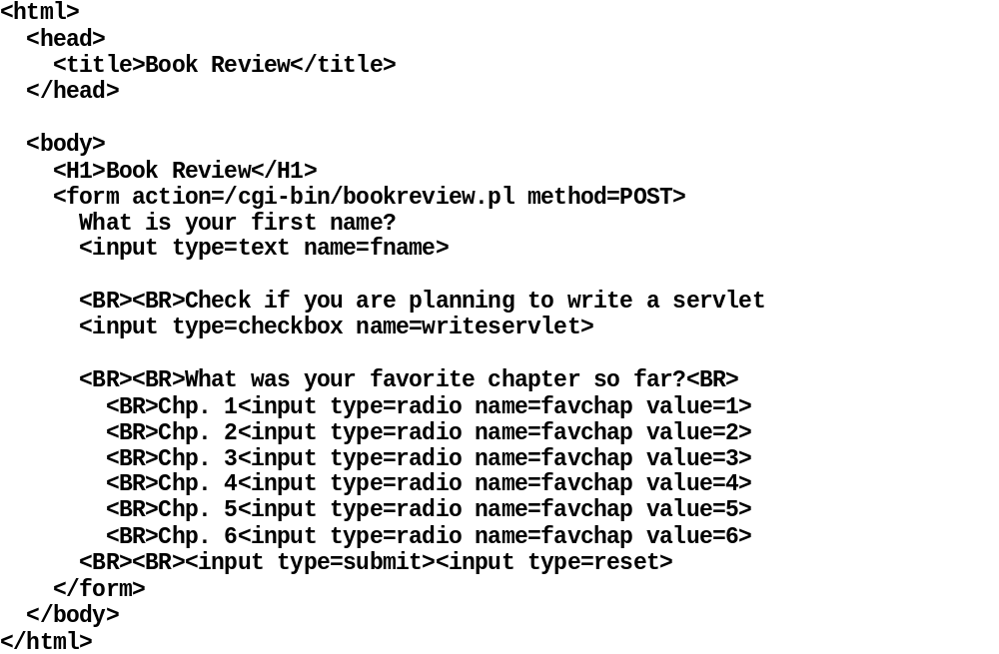

Slide 15
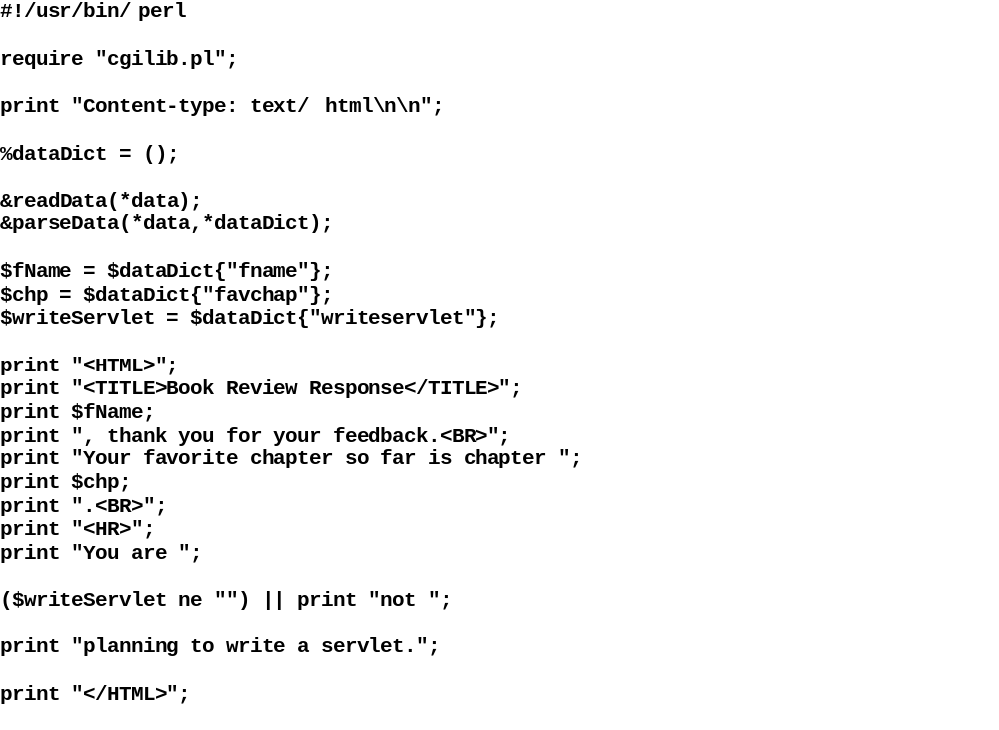

Slide 16
Comparison
Servlets work on any servlet-enabled server
Portable
CGI: Request, open process, shut down
Not persistent. Restablish resources each time
Each request requires new CGI process
Single process with no IPC

Slide 17
<form
action=http://localhost:8080/servlet/BookReviewServlet
method=POST>

Slide 18
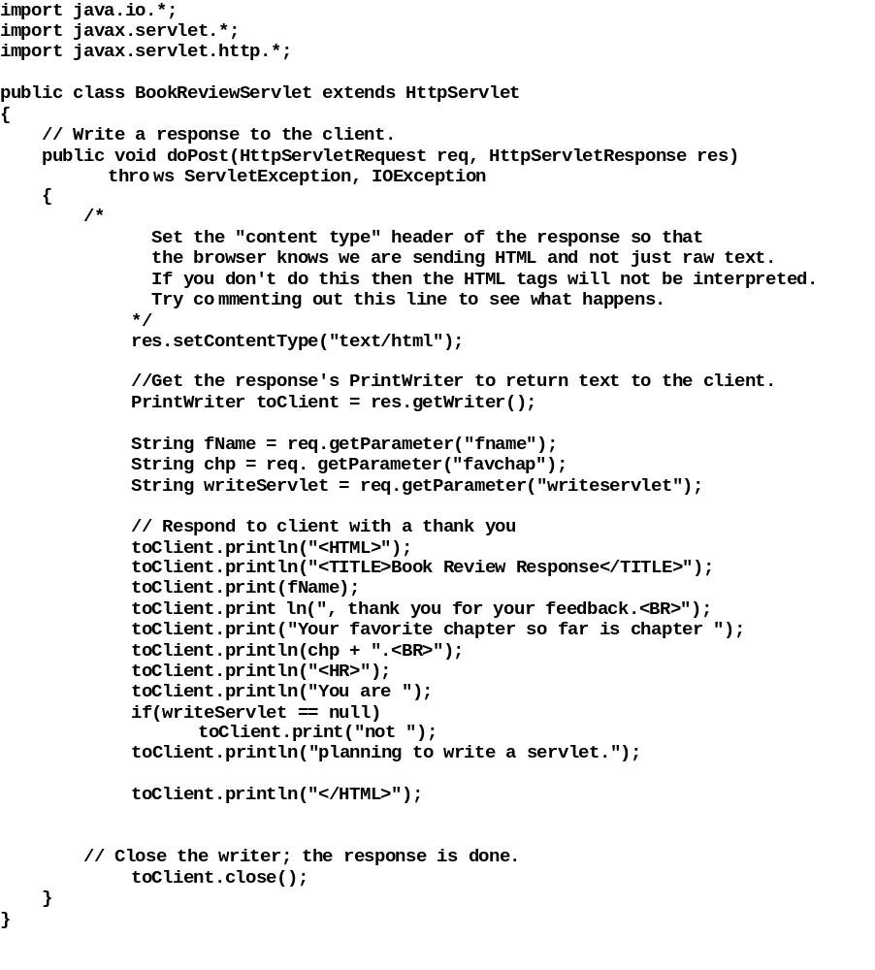

Slide 19
HTML Forms
FORM: container for a form with control elements for user to interact with
Data is entered from a number of controls
text boxes, radio buttons,
INPUT: specifies controls as input elements to FORM
http://webreference.com

Slide 20
The FORM element is a container for a form. It doesn't actually do anything special by itself,
but it can contain form controls that make up the form and are displayed for the user to manipulate.
The FORM element
Context:
This is a block element (but see below)
Contents:
May contain block-level elements and form controls. Cannot be nested.
Tags:
Both start-tag and end-tag are required.
Attributes for the FORM element
action (URI)
The URI that is used for form submission.
method (get or post)
The method used for form submission, get or post
enctype (Content type)
The MIME content type that should be used for encoding the form data when it is submitted.
The default is application/x-www-form-urlencoded. An
alternative is multipart/form-data when sending files (see below).
accept (List of content types)
A space- or comma-separated list of MIME content types that may be sent (as files) when submitting the form.
accept-charset (List of character sets)
A space- or comma-separated list of character sets that the form data may be in. The default is the character set of the document.
Identifier and classification attributes
Language information attributes
Inline style information attribute
Title attribute
Intrinsic event handler attributes

Slide 21
The INPUT element
Context:
Can only appear inside a FORM element
Contents:
This is an empty element
Tags:
Empty element; Start-tag is required, end-tag is forbidden
Attributes for the INPUT element
TYPE (Control type)
A contol's type can be one of text, password, checkbox, radio, submit, reset, file, hidden, image or button.
An explanation of each is given
below.
NAME (Name)
The name that will be used for the name/value pair that the control creates.
VALUE (Text)
The default value for the control. The precise handling of this value depends on the type of control.
SIZE (Integer)
In the case of text and password controls, this is the number of characters that will fit into the control. In other cases, it is the
default width of the control in
pixels. The latter use is discouraged. Both uses can theoretically be replaced by CSS, although this is not possible with all current browsers.
MAXLENGTH (Integer)
Only applicable to text and password controls, this attribute sets the maximum size of the string that can be entered.
By default, there is no limit. If the
maximum size is larger than that specified in the SIZE attribute, the browser must use some form of scrolling to allow the
user to enter more data than can be
seen at one time.
CHECKED (Boolean)
Only applicable to radio and checkbox controls, this attribtue specifies that the controls should be selected by default.
SRC (URI)
Only applicable to image controls, this attribute specifies the location of the image to be used in the control.
accept (List of content types)
Applicable only to file controls. A space- or comma-separated list of MIME content types that may be sent (as files)
when submitting the form. This
overrides the value of the accept attribute on the form element.

Slide 22
<FORM ACTION="/cgi-bin/html/formdump.cgi" METHOD="GET" ENCTYPE="application/x-www-form-urlencoded">
<P>Enter e-mail:
<INPUT
TYPE="text"
NAME="email"
VALUE="user@domain.com"
SIZE="16"
MAXLENGTH="50"
>
<INPUT TYPE="submit" VALUE="Submit">
</FORM>
<FORM ACTION="/cgi-bin/html/formdump.cgi" METHOD="GET" ENCTYPE="application/x-www-form-urlencoded">
<P>Username: <INPUT TYPE="text" NAME="user" SIZE="8">
<BR>Password: <INPUT TYPE="password" NAME="pass" SIZE="8">
<BR><INPUT TYPE="submit" VALUE="Submit">
</FORM>

Slide 23
<FORM ACTION="/cgi-bin/html/formdump.cgi" METHOD="GET" ENCTYPE="application/x-www-form-urlencoded">
<P>E-mail address: <INPUT TYPE="text" NAME="email" SIZE="20">
<P><INPUT TYPE="checkbox" NAME="use" VALUE="subscribe" CHECKED>
Subscribe to our newsletter
<BR><INPUT TYPE="checkbox" NAME="use" VALUE="mailing">
Check this box if you do not want to receive e-mails about our products.
<BR><INPUT TYPE="submit" VALUE="Submit">
</FORM>
<FORM ACTION="/cgi-bin/html/formdump.cgi" METHOD="GET" ENCTYPE="application/x-www-form-urlencoded">
<P>E-mail address: <INPUT TYPE="text" NAME="email" SIZE="20">
<P>Please select which format you would like to receive our newsletter in:
<BR><INPUT TYPE="radio" NAME="format" VALUE="text" CHECKED> Text
<BR><INPUT TYPE="radio" NAME="format" VALUE="html"> HTML
<BR><INPUT TYPE="radio" NAME="format" VALUE="pdf"> Adobe Acrobat
<P><INPUT TYPE="submit" VALUE="Submit">
</FORM>

Slide 24
<FORM METHOD="POST" ACTION="/cgi-bin/html/formdump.cgi" ENCTYPE="multipart/form-data">
<H2>Graphics Contest</H2>
<P>Name: <INPUT TYPE="text" NAME="name" SIZE="30">
<P>Please submit your entry in PNG or GIF format:
<INPUT TYPE="file" NAME="entry" ACCEPT="image/png, image/gif">
<P><INPUT TYPE="submit">
</FORM>
<FORM ACTION="/cgi-bin/html/formdump.cgi" METHOD="GET" ENCTYPE="application/x-www-form-urlencoded">
<P>Enter your e-mail address:
<INPUT TYPE="text" NAME="email" SIZE="30">
<P>Subscribe
<INPUT TYPE="radio" NAME="action" VALUE="subscribe">
Unsubscribe
<INPUT TYPE="radio" NAME="action" VALUE="unsubscribe" CHECKED>
<INPUT TYPE="submit" VALUE="Submit">
</FORM>

